Slide 1

Data Integration and Large Scale Analysis
06 Data Cleaning
Last update: Nov 04, 2022

Slide 2
Agenda
Motivation and Terminology
Data Cleaning and Fusion
Missing Value Imputation

Slide 3
Motivation and Terminology

Slide 4
Recap: Corrupted/Inconsistent Data
Motivation and Terminology
#1 Heterogeneity of Data Sources
  Update anomalies on denormalized data / eventual consistency
  Changes of app/prep over time (US vs us) → inconsistencies
#2 Human Error
  Errors in semi-manual data collection, laziness (see default values), bias
  Errors in data labeling (especially if large-scale: crowd workers / users)
#3 Measurement/Processing Errors
  Unreliable HW/SW and measurement equipment (e.g., batteries)
  Harsh environments (temperature, movement) → aging
Uniqueness & duplicates
Contradictions & wrong values
Missing Values
[Credit: Felix Naumann]
Ref. Integrity
ID | Name | BDay | Age | Sex | Phone | Zip
3 | Smith, Jane | 05/06/1975 | 44 | F | 999-9999 | 98120
3 | John Smith | 38/12/1963 | 55 | M | 867-4511 | 11111
7 | Jane Smith | 05/06/1975 | 24 | F | 567-3211 | 98120
Zip | City
98120 | San Jose
90001 | Lost Angeles
Typos

Slide 5
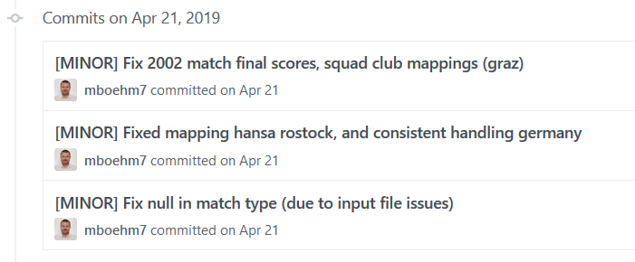
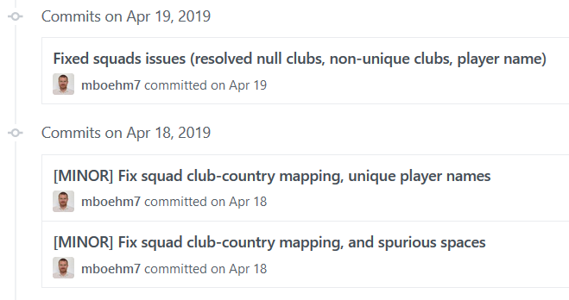
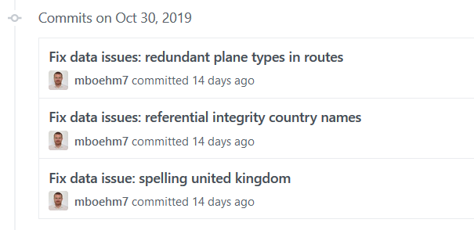

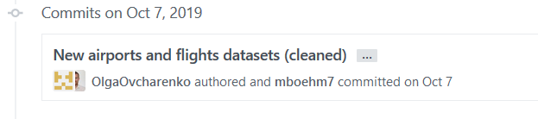



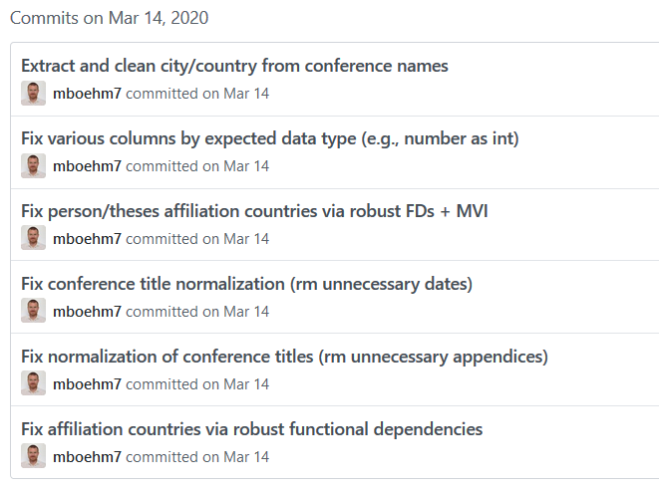
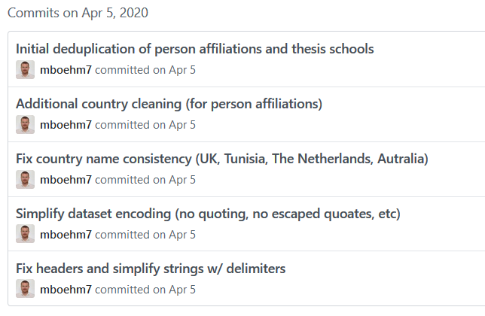
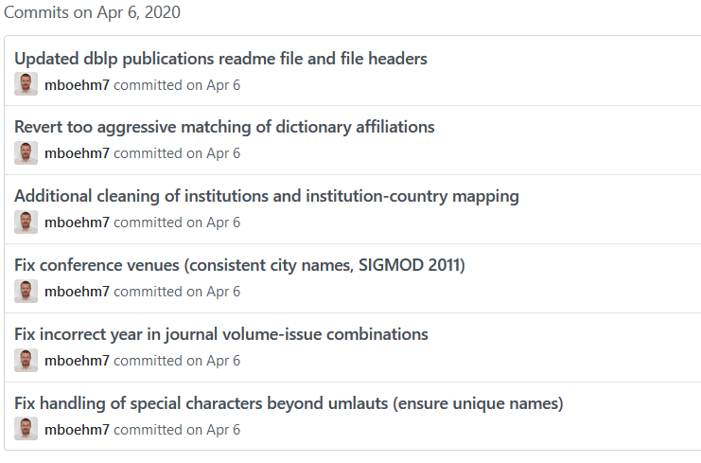
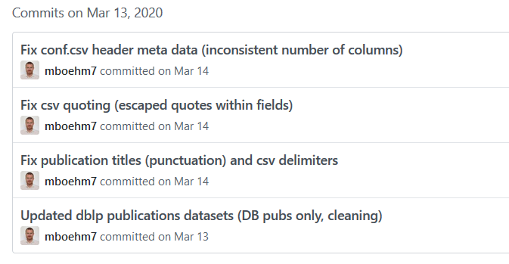
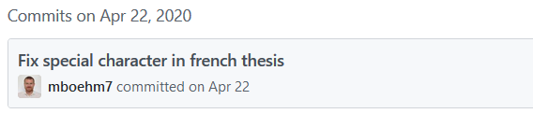
Examples (aka errors are everywhere)
Motivation and Terminology
DM SS’19
(Soccer
World Cups)
DM WS’19/20
(Airports and Airlines)
DM SS’20
(DBLP Publications)
☺

Slide 6
Terminology
Motivation and Terminology
#1 Data Cleaning (aka Data Cleansing)
  Detection and repair of data errors
  Outliers/anomalies: values or objects that do not match normal behavior
  (different goals: data cleaning vs finding interesting patterns)
  Data Fusion: resolution of inconsistencies and errors
  (e.g., entity resolution see Lecture 05)
#2 Missing Value Imputation
  Fill missing info with “best guess”
  Difference between NAs and 0 (or special values like NaN) for ML models
#3 Data Wrangling
  Automatic cleaning unrealistic? → Interactive data transformations
  Recommended transforms + user selection
Note: Partial Overlap w/ KDDM ➔ it’s fine, different perspectives

Slide 7
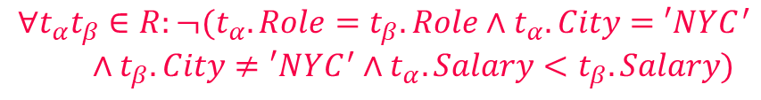
Express Expectations as Validity Constraints
Motivation and Terminology
Manual Approach: “Common Sense”
(Semi-)Automatic Approach: Expectations!
  PK → Values must be unique and defined (not null)
  Exact PK-FK → Inclusion dependencies
  Noisy PK-FK → Robust inclusion dependencies |R[X]∈S[Y]| / |R[X]| > δ
  Semantics of attributes → Value ranges / # distinct values
  Invariant to capitalization
  → Duplicates that differ in capitalization
  Patterns → regular expressions
Formal Constraints
  Functional dependencies (FD), conditional FDs (CFD), metric dependencies
  Inclusion dependencies, matching dependencies
  Denial constraints
Route
(Airline, From, To)
Planes
Age=9999?
2019-11-15 vs Nov 15, 2019
$$∀t_{α}t_{β}∈R:¬(t_{α}.Role=t_{β}.Role∧t_{α}.City=′NYC^{′}$$
$∧t_{β}.City≠′NYC^{′}∧t_{α}.Salary<t_{β}.Salary)$

Slide 8
Data Cleaning and Fusion

Slide 9
Data Validation
Data Cleaning and Fusion
validation checks on expected shape
before training first model
Check a feature’s min, max, and most common value
  Ex: Latitude values must be within the range [-90, 90] or [-π/2, π/2]
The histograms of continuous or categorical values are as expected
  Ex: There are similar numbers of positive and negative labels
Whether a feature is present in enough examples
  Ex: Country code must be in at least 70% of the examples
Whether a feature has the right number of values (i.e., cardinality)
  Ex: There cannot be more than one age of a person
[Neoklis Polyzotis, Sudip Roy, Steven Euijong Whang, Martin Zinkevich: Data Management Challenges in Production Machine Learning. Tutorial, SIGMOD 2017]
(Google Research)

Slide 10
Data Validation, cont.
Data Cleaning and Fusion
[Sebastian Schelter, Dustin Lange, Philipp Schmidt, Meltem Celikel, Felix Bießmann, Andreas Grafberger: Automating Large-Scale Data Quality Verification. PVLDB 2018]
Constraints
and Metrics
for quality
check UDFs
Approach
  #1 Quality checks on basic metrics, computed in Apache Spark
  #2 Incremental maintenance of metrics and quality checks
(Amazon Research)
Organizational Lesson: benefit of shared vocabulary/procedures
Technical Lesson: fast/scalable; reduce manual and ad-hoc analysis
Notes:
Data to Models and Back DEEM workshop see if u can extend TFDV

Slide 11
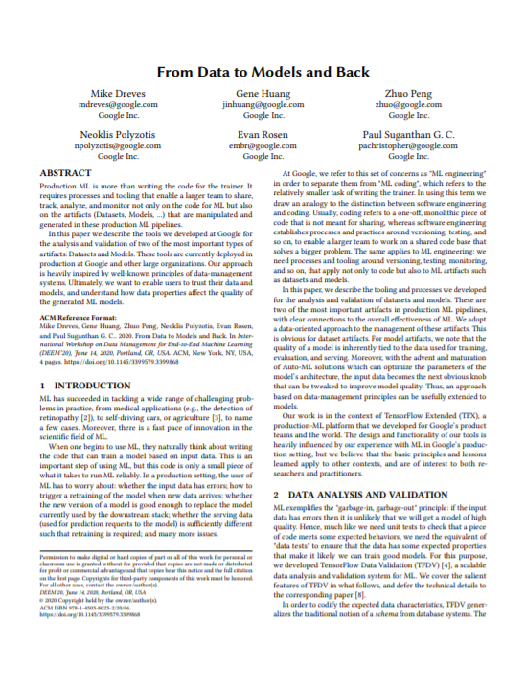
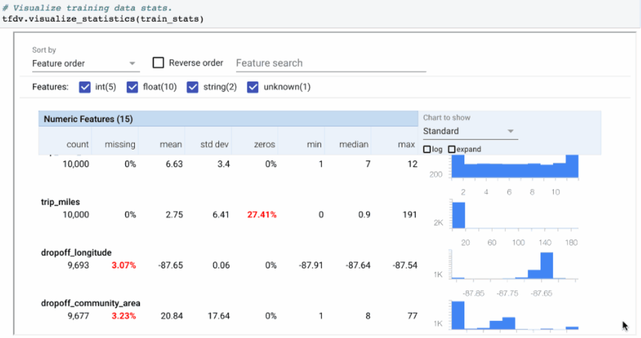
Data Validation, cont.
Data Cleaning and Fusion
[Mike Dreves; Gene Huang; Zhuo Peng; Neoklis Polyzotis; Evan Rosen; Paul Suganthan: From Data to Models and Back. DEEM 2020]
TensorFlow Data Validation (TFDV)
  Library or TFX components
  Provides functions for stats computation,
  validation checks and anomaly detection
(Google)

Slide 12
Standardization and Normalization
Data Cleaning and Fusion
#1 Standardization
  Centering and scaling to
  mean 0 and variance 1
  Ensures well-behaved training
  Densifying operation
  Awareness of NaNs
  Batch normalization in DNN: standardization of activations
#2 Normalization
  Aka min-max normalization
  Rescale values into common range [0,1]
  Avoid bias to large-scale features
  Does not handle outliers
X = X – colMeans(X);
X = X / sqrt(colVars(X));
X = replace(X, pattern=NaN,
replacement=0); #robustness
X = (X – colMins(X))
/ (colMaxs(X) – colMins(X));

Slide 13
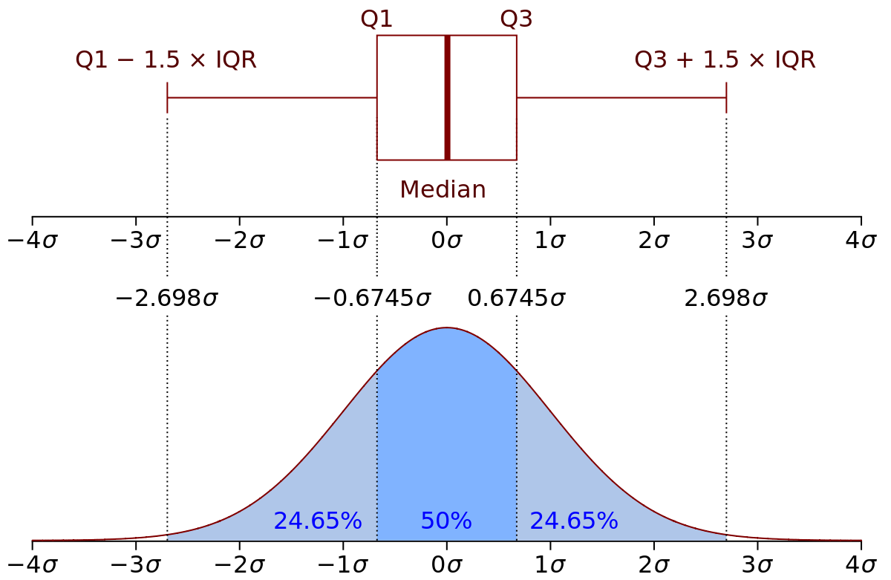
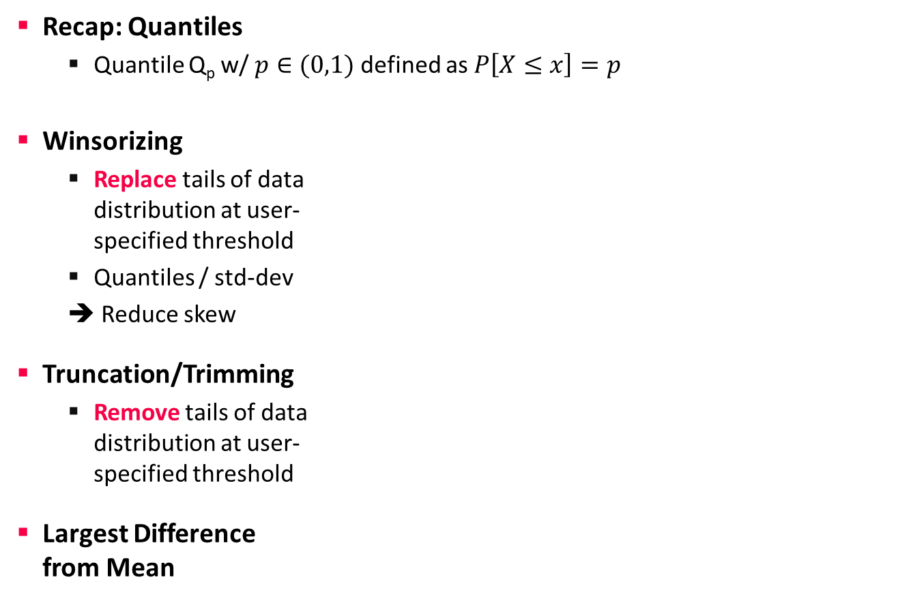
Winsorizing and Trimming
Data Cleaning and Fusion
Recap: Quantiles
  Quantile Q_{p} w/ $p∈(0,1)$ defined as $P\left[X≤x\right]=p$
Winsorizing
  Replace tails of data
  distribution at user-
  specified threshold
  Quantiles / std-dev
  ➔ Reduce skew
Truncation/Trimming
  Remove tails of data
  distribution at user-
  specified threshold
Largest Difference
from Mean
[Credit: https://en.wikipedia.org]
# compute quantiles for lower and upper
ql = quantile(X, 0.05);
qu = quantile(X, 0.95);
# replace values outside [ql,qu] w/ ql and qu
Y = ifelse(X < ql, ql, X);
Y = ifelse(Y > qu, qu, Y);
SystemDS: winsorize() outlier()
# remove values outside [ql,qu]
I = X < qu | X > ql;
Y = removeEmpty(X, “rows”, select = I);
# determine largest diff from mean
I = (colMaxs(X)-colMeans(X))
> (colMeans(X)-colMins(X));
Y = ifelse(xor(I,op), colMaxs(X), colMins(X));
Notes:
Box and whisker plots
SystemDS: quantiles via sort+pick, quickselect possible
Iterative winsoring/trimming to X std-devs of mean also possible

Slide 14
Winsorizing and Trimming, cont.
Data Cleaning and Fusion
SystemDS outlierByIQR
  less than Q1 – ( k×IQR ) or greater than
  Q3 + ( k×IQR ) → outlier
SystemDS outlierBySd
  less than mean – ( k×stdev ) or greater than
  mean + ( k×stdev ) → outlier
Methods for Handling Outliers
  Replace outliers with default values (constants or mean/median/mode)
  Update outliers as missing values
  Data clipping
Q1
median
Q3
Q1 – 1.5 * IQR
IQR
Q3 + 1.5 * IQR
Outlier
-3σ
-2σ
-1σ
µ
1σ
2σ
3σ
Notes:
Box and whisker plots
SystemDS: quantiles via sort+pick, quickselect possible
Iterative winsoring/trimming to X std-devs of mean also possible

Slide 15
Outliers and Outlier Detection
Data Cleaning and Fusion
Types of Outliers
  Point outliers: single data points
  far from the data distribution
  Contextual outliers: noise or other systematic anomalies in data
  Sequence (contextual) outliers: sequence of values w/ abnormal shape/agg
  Univariate vs multivariate analysis
  Beware of underlying assumptions (distributions)
Types of Outlier Detection
  Type 1 Unsupervised: No prior knowledge
  of data, similar to unsupervised clustering
  → expectations: distance, # errors
  Type 2 Supervised: Labeled normal and abnormal
  data, similar to supervised classification
  Type 3 Normal Model: Represent normal behavior,
  similar to pattern recognition → expectations: rules/constraints
[Varun Chandola, Arindam Banerjee, Vipin Kumar: Anomaly detection: A survey. ACM Comput. Surv. 2009]
[Victoria J. Hodge, Jim Austin: A Survey of Outlier Detection Methodologies. Artif. Intell. Rev. 2004]

Slide 16
Outlier Detection Techniques
Data Cleaning and Fusion
Classification
  Learn a classifier using labeled data
  Binary: normal / abnormal
  Multi-class: k normal / abnormal (one against the rest) → none=abnormal
  Examples: AutoEncoders, Bayesian Networks, SVM, decision trees
K-Nearest Neighbors
  Anomaly score: distance to kth nearest neighbor
  Compare distance to threshold + (optional) max number of outliers
Clustering
  Clustering of data points, anomalies are points not assigned / too far away
  Examples: DBSCAN (density), K-means (partitioning)
  Cluster-based local outlier factor (global, local, and size-specific density)
[Varun Chandola, Arindam Banerjee, Vipin Kumar: Anomaly detection: A survey. ACM Comput. Surv. 2009]
Notes:
Coverage analysis search coverage in slicing paper
XGBoost

Slide 17
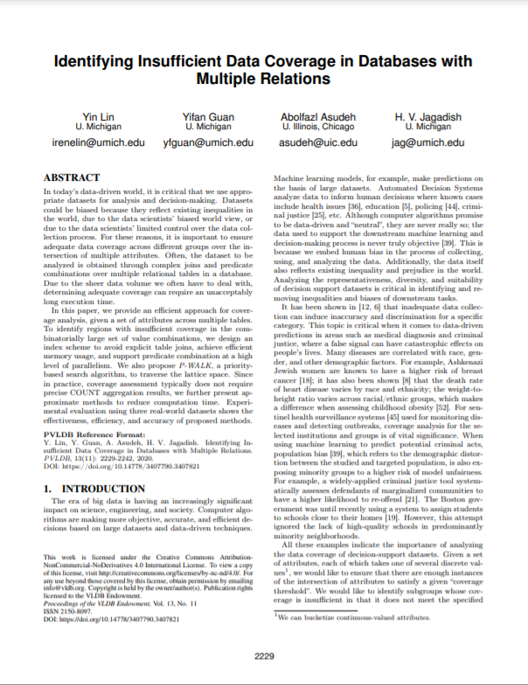
Outlier Detection Techniques, cont.
Data Cleaning and Fusion
Frequent Itemset Mining
  Rare itemset mining / sequence mining;
  Examples: Apriori/Eclat/FP-Growth
  Coverage Analysis
    Given a database D and a data pattern P
    Coverage of a data pattern cov(P) is
    defined as the number of records in
    table T that satisfy pattern P
    Pattern P is a covered pattern if cov(P) ≥ τ
    Otherwise, this pattern is said to be uncovered
TID | Items
1 | Bread, Milk
2 | Bread, Diaper, Beer, Eggs
3 | Milk, Diaper, Beer, Coke
4 | Bread, Milk, Diaper, Beer
5 | Bread, Milk, Diaper, Coke
[Yin Lin et al: Identifying Insufficient Data Coverage in Databases with multiple Relations. PVLDB 2020]
Notes:
Coverage analysis search coverage in slicing paper
XGBoost

Slide 18
Time Series Anomaly Detection
Data Cleaning and Fusion
Basic Problem Formulation
  Given regular (equi-distant) time series of measurements
  Detect anomalous subsequences s of length l (fixed/variable)
Anomaly Detection
  #1 Supervised: Classification problem
  #2 Unsupervised: k-Nearest Neighbors
  (discords) → All-pairs similarity join
[Matrix Profile XIV, SoCC’19]
[Chin-Chia Michael Yeh et al: Matrix Profile I: All Pairs Similarity Joins for Time Series: A Unifying View That Includes Motifs, Discords and Shapelets. ICDM 2016]

Slide 19
Automatic Data Repairs
Data Cleaning and Fusion
Overview Repairs
  Question: Repair data, rules/constraints, or both?
  General principle: “minimality of repairs”
Example Data Repair
  Functional dependency A→ B
  Violation for A=1
Note: Piece-meal vs holistic data repairs
[Xu Chu, Ihab F. Ilyas: Qualitative Data Cleaning. Tutorial, PVLDB 2016]
OK, dist=1
A | B
1 | 2
1 | 3
1 | 3
4 | 5
A | B
1 | 3
1 | 3
1 | 3
4 | 5
A | B
1 | 2
1 | 2
1 | 2
4 | 5
A | B
1 | 5
1 | 5
1 | 5
4 | 5
vs
vs

Slide 20
Automatic Data/Rule Repairs, cont.
Data Cleaning and Fusion
Example
  Expectation: City → Country;
  new data conflicts
Relative Trust: {FName, LName} → Salary
  Trusted FD: ➔ change salary according to {FName, LName} → Salary
  Trusted Data: ➔ change FD to {FName, LName, DoB, Phone} → Salary
  Equally-trusted: ➔ change FD to
  {FName, LName, DoB} → Salary
  AND data accordingly
[George Beskales, Ihab F. Ilyas, Lukasz Golab, Artur Galiullin: On the relative trust between inconsistent data and inaccurate constraints. ICDE 2013]
IATA | ICAO | Name | City | Country
MEL | YMML | Melbourne International Airport | Melbourne | Australia
MLB | KMLB | Melbourne International Airport | Melbourne | USA
x
x
x
x
x
x
Max d changes
dist_{D}
x
x
x
x
dist_{C}

Slide 21
Excursus: Simpson’s Paradox
Data Cleaning and Fusion
Overview: Statistical paradox stating that an analysis of groups may yield different results at different aggregation levels
Example UC Berkeley ‘73
 | Men |  | Women
 | Appl. | Adm. | Appl. | Adm.
A | 825 | 62% | 108 | 82%
B | 560 | 63% | 25 | 68%
C | 325 | 37% | 593 | 34%
D | 417 | 33% | 375 | 35%
E | 191 | 28% | 393 | 24%
F | 373 | 6% | 341 | 7%
 | Applicants | Admitted
Men | 8442 | 44%
Women | 4321 | 35%
➔ more women had applied to departments that admitted a small percentage of applicants
“The real Berkeley story
A Wall Street Journal interview with Peter Bickel, one of the statisticians involved in the original study, makes clear that Berkeley was never sued—it was merely afraid of being sued”
[https://www.refsmmat.com/
posts/2016-05-08-simpsons
-paradox-berkeley.html]

Slide 22
Selected Research
Data Cleaning and Fusion
[Jiannan Wang et al: A sample-and-clean framework for fast and accurate query processing on dirty data. SIGMOD 2014]
ActiveClean (SampleClean)
  Suggest sample of data for manual cleaning
  (rule/ML-based detectors, Simpson's paradox)
  Example
  Linear
  Regression
  Approach: Cleaning and training as form of SGD
    Initialization: model on dirty data
    Suggest sample of data for cleaning
    Compute gradients over newly cleaned data
    Incrementally update model w/ weighted gradients of previous steps
[Sanjay Krishnan et al: ActiveClean: Interactive Data Cleaning For Statistical Modeling. PVLDB 2016]

Slide 23
Selected Research, cont.
Data Cleaning and Fusion
HoloClean
  Clean and enrich based on quality rules,
  value correlations, and reference data
  Probabilistic models for capturing data generation
  HoloDetect
    Learn data representations of errors
    Data augmentation w/ erroneous
    data from sample of clean data
    (add/remove/exchange characters)
Other Systems
  AlphaClean (generate data cleaning pipelines) [preprint 2019]
  BoostClean (generate repairs for domain value violations) [preprint 2017]
  CPClean (prioritize repairs on incomplete data)[Bojan Karlaš et al. PVLDB 2021]
[Theodoros Rekatsinas, Xu Chu, Ihab F. Ilyas, Christopher Ré: HoloClean: Holistic Data Repairs with Probabilistic Inference. PVLDB 2017]
[Alireza Heidari, Joshua McGrath, Ihab F. Ilyas, Theodoros Rekatsinas: HoloDetect: Few-Shot Learning for Error Detection, SIGMOD 2019]

Slide 24
Query Planning w/ Data Cleaning
Data Cleaning and Fusion
Problem
  Given query tree or data flow graph
  Find placement of data cleaning operators
  to reduce costs
Approach
  Budget B of user actions
  Active learning user feedback on query results
  Map query results back to sources
  via lineage
  Cleaning in decreasing order of impact
Extensions?
  Query-aware placement/refinement (e.g., UK) of cleaning primitives
  Ordering of cleaning primitives (norm, dedup, missing value?)
[Dong Deng et al: The Data Civilizer System. CIDR 2017]
⨝
σ_{UK}
S
dedup
R

Slide 25


Data Wrangling
Data Cleaning and Fusion
[Vijayshankar Raman, Joseph M. Hellerstein: Potter's Wheel: An Interactive Data Cleaning System. VLDB 2001]
Data Wrangler Overview
  Interactive data cleaning via
  spreadsheet-like interfaces
  Iterative structure inference,
  recommendations, and
  data transformations
  Predictive interaction
  (infer next steps from interaction)
Commercial/Free Tools
  Trifacta (from Data Wrangler)
  Google Fusion Tables: semi-automatic
  resolution and deduplication (sunset Dec 2019)
[Sean Kandel, Andreas Paepcke, Joseph M. Hellerstein, Jeffrey Heer: Wrangler: interactive visual specification of data transformation scripts. CHI 2011]
[Jeffrey Heer, Joseph M. Hellerstein, Sean Kandel: Predictive Interaction for Data Transformation. CIDR 2015]

Slide 26
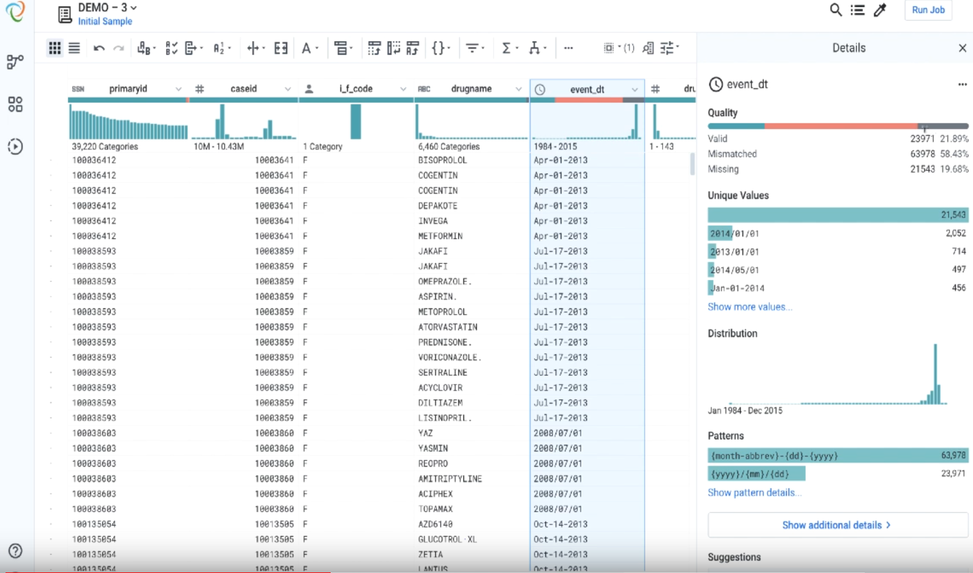
Data Wrangling, cont.
Data Cleaning and Fusion
[Credit: Alex Chan (Apr 2, 2019) https://www.trifacta.com/blog/trifacta-for-data-quality-introducing-smart-cleaning/]
Example: Trifacta Smart Cleaning

Slide 27
Missing Value Imputation

Slide 28
Basic Missing Value Imputation
Missing Value Imputation
Missing Value
  Application context defines if 0 is missing value or not
  If differences between 0 and missing values, use NA or NaN?
  Could be a number outside the domain or symbol as ‘?’
Relationship to Data Cleaning
  Missing value is error, need to generate data repair
  Data imputation techniques can be used as outlier/anomaly detectors
Recap: Reasons
  #1 Heterogeneity of Data Sources
  #2 Human Error
  #3 Measurement/Processing Errors
MCAR: Missing Completely
at Random
MAR: Missing at Random
MNAR: Missing Not at Random

Slide 29
Basic Missing Value Imputation
Missing Value Imputation
ID | Position | Salary ($)
1 | Manager | null
2 | Secretary | 2200
3 | Manager | 3600
4 | Technician | null
5 | Technician | 2500
6 | Secretary | null
Missing Completely at Random
  Missing values are randomly distributed
  across all records (independent from
  recorded or missing values)
Missing at Random
  Missing values are randomly distributed
  within one or more sub-groups of records
  Missing values depend on the recorded but not
  on the missing values, and can be recovered
Not Missing at Random
  Missing data depends on the missing
  values themselves
  E.g., missing low salary, age, weight, etc.
(3500)
(2400)
(2000)
ID | Position | Salary ($)
1 | Manager | 3500
2 | Secretary | 2200
3 | Manager | 3600
4 | Technician | null
5 | Technician | null
6 | Secretary | 2000
ID | Position | Salary ($)
1 | Manager | 3500
2 | Secretary | null
3 | Manager | 3600
4 | Technician | null
5 | Technician | 2500
6 | Secretary | null
[Abdulhakim Ali Qahtan, Ahmed K. Elmagarmid, Raul Castro Fernandez, Mourad Ouzzani, Nan Tang: FAHES: A Robust Disguised Missing Values Detector. KDD 2018]
<= 2400
missing

Slide 30
Basic Missing Value Imputation, cont.
Missing Value Imputation
Basic Value Imputation (for MCAR)
  General-purpose: replace by user-specified constant,
  or drop records, or one-hot encode as separate column
  Continuous variables: replace by mean, median
  Categorical variables: replace by mode (most frequent category)
Iterative Algorithms (chained-equation imputation for MAR)
  Train ML model on available data to predict missing information
    Initialize with basic imputation (e.g., mean)
    One dirty variable at a time
    Feature k → label, split data into
    training: observed / scoring: missing
    Types: categorical → classification,
    continuous → regression
  Noise reduction: train models over feature subsets + averaging
[Stef van Buuren, Karin Groothuis-Oudshoorn: mice: Multivariate Imputation by Chained Equations in R,
J. of Stat. Software 2011]

Slide 31
Basic Missing Value Imputation, cont.
Missing Value Imputation
MICE example
  Initialization: fill in the missing values with column mean (w/ or w/o NAs)
  Iterations: each column per iteration
V1 | V2 | V3 | V4 | V5
1 | 56 | 2 | 2 | 2
2 | 23 | 0 | 0 | 0
1 | NA | 0 | 0 | 2
2 | 24 | -1 | 2 | NA
NA | 22 | 1 | 2 | 0
V1 | V2 | V3 | V4 | V5
1 | 56 | 2 | 2 | 2
2 | 23 | 0 | 0 | 0
1 | 25 | 0 | 0 | 2
2 | 24 | -1 | 2 | 0.8
1.2 | 22 | 1 | 2 | 0
train(y)
train(x)
V1 | V2 | V3 | V4 | V5
1 | 56 | 2 | 2 | 2
2 | 23 | 0 | 0 | 0
1 | 25 | 0 | 0 | 2
2 | 24 | -1 | 2 | 0.8
1.2 | 22 | 1 | 2 | 0
V1 | V2 | V3 | V4 | V5
1 | 56 | 2 | 2 | 2
2 | 23 | 0 | 0 | 0
1 | 25 | 0 | 0 | 2
2 | 24 | -1 | 2 | 0.8
? | 22 | 1 | 2 | 0
test(x)

Slide 32
BREAK (and Test Yourself)
Missing Value Imputation
[Exam Feb 08, 2021]
Two techniques for MVI in the categorical column C.
If possible, provide the imputed values (6 points)
  Mode ➔ {X, X}
  Functional Dependency (e.g., B/1000→C) ➔ {Y, Z}
  ML (Classification)
Two techniques for MVI in the numerical column E.
If possible, provide the imputed values (6 points)
  Mean ➔ {35, 35}
  Functional Dependency (e.g., D→E) ➔ {35, 45}
  ML (Regression)

Slide 33
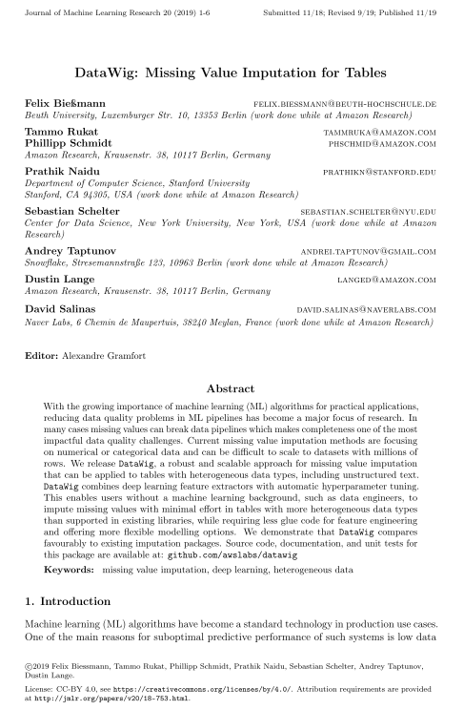
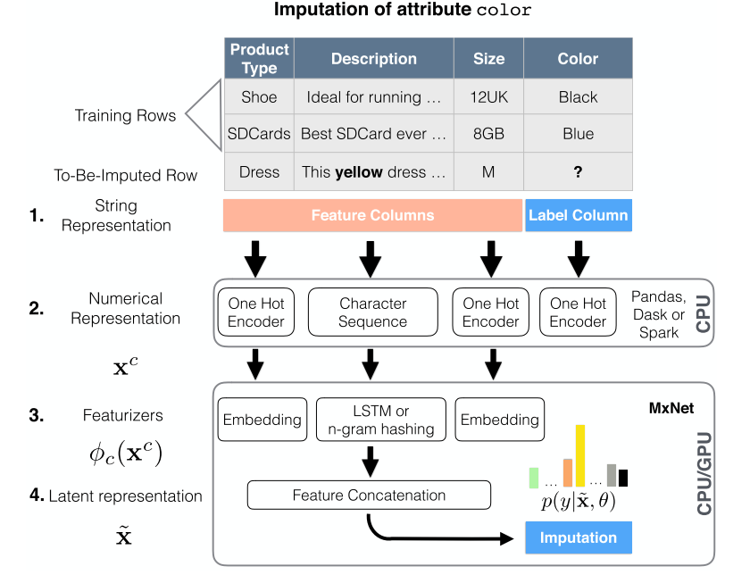
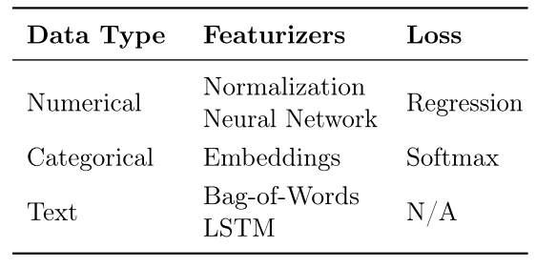
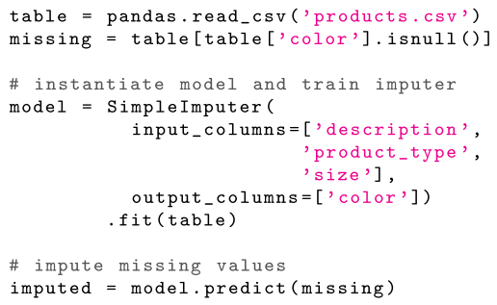
DNN Based MV Imputation
Missing Value Imputation
[Felix Bießmann et al: DataWig: Missing Value Imputation for Tables, J. of ML Research 2019]
DataWig
  Missing values imputation for heterogeneous data including unstructured text

Slide 34
Query Planning w/ MV Imputation
Missing Value Imputation
Dynamic Imputation
  Data exploration w/ on-the-fly imputation
  Optimal placement of drop δ and impute μ
  (chained-equation imputation via decision trees)
  Multi-objective optimization
[Jose Cambronero, John K. Feser, Micah Smith, Samuel Madden:
Query Optimization for Dynamic Imputation. PVLDB 2017]
Quality Optimized
Plan
Perf Optimized
Plan

Slide 35
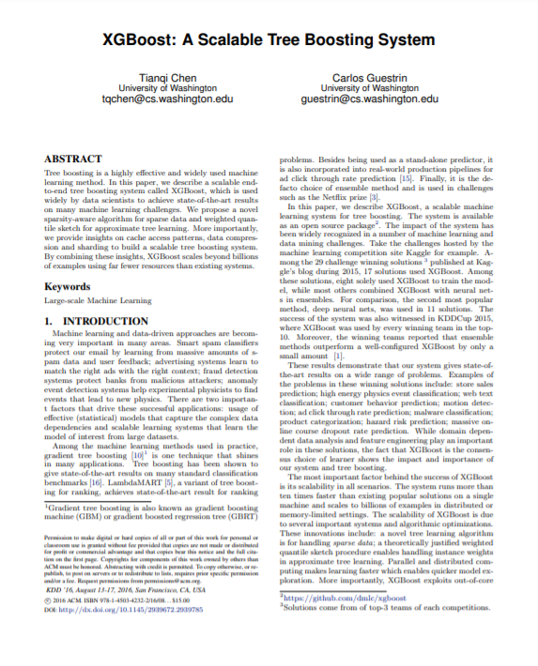
XGBoost’s Sparsity-aware Split Finding
Missing Value Imputation
Motivation
  Missing values
  Sparsity in general
  (zero values, one-hot encoding)
XGBoost
  Implementation of gradient
  boosted decision trees
  Multi-threaded, cache-conscious
Sparsity-aware Split Finding
  Handles the missing values by
  default paths (learned from data)
  An example will be classified into the
  default direction when the feature
  needed for the split is missing
[Tianqi Chen and Charlos Guestrin: XGBoost: A Scalable Tree Boosting System, KDD 2016]
Example | Age | Gender
X1 | ? | male
X2 | 15 | ?
X3 | 25 | female
age < 20
Y
N
default
Is male?
X3
Y
N
X1
default
X2

Slide 36
Time Series Imputation
Missing Value Imputation
[Steffen Moritz and Thomas Bartz-Beielstein: imputeTS: Time Series Missing Value Imputation in R, The R Journal 2017]
Example R Package imputeTS

Slide 37
Summary and Q&A
Motivation and Terminology
Data Cleaning and Fusion
Missing Value Imputation
Next Lectures (Part B)
  08 Cloud Computing Foundations [Nov 18]
  09 Cloud Resource Management and Scheduling [Nov 25]
  10 Distributed Data Storage [Dec 02]
  11 Distributed, Data-Parallel Computation [Jan 13]
  12 Distributed Stream Processing [Jan 20]
  13 Distributed Machine Learning Systems [Jan 27]

