Slide 1

Data Integration and Large Scale Analysis
01 Introduction and Overview
Slides credit: Matthias Boehm
Last update: Oct 06, 2023

Slide 2

Announcements/Org
#1 Video Recording
  Link in TUbe & TeachCenter
  Optional attendance
  Hybrid, in-person but video-recorded lectures
    HS i5 and Webex: https://tugraz.webex.com/meet/shafaq.siddiqi

Slide 3
Agenda
Course Organization
Course Motivation and Goals
Course Outline and Projects

Slide 4


About Me
Data Management Group
09/2019 TU Graz, Austria
  Teaching Assistant, TU Graz
  Institute of Interactive Systems and Data Science, CSBME
  (ML systems internals, end-to-end data science lifecycle)
2017-2019 Sukkur IBA University
  Lecturer (Computer Science)
  Teaching and supervising FYPs in Bachelor programs
2020 PhD Student TU Graz, Austria
  Data preprocessing for Heterogeneous Large Scale Data
  Generation and Optimization of Data Cleaning Pipelines
https://github.com/apache/systemds
Data Management group

Slide 5
Course Organization

Slide 6
Basic Course Organization
Course Organization
Staff
  Lecturer: M.Sc. Shafaq Siddiqi, ISDS
Language
  Lectures and slides: English
  Communication and examination: English
Course Format
  VU 2/1, 5 ECTS (2x 1.5 ECTS + 1x 2 ECTS), bachelor/master
  Weekly lectures (Fri 3pm, including Q&A), attendance optional
  Mandatory exercises or programming project (2 ECTS)
  Recommended papers for additional reading on your own
Prerequisites
  Preferred: course Data Management / Databases is very good start
  Sufficient: basic understanding of SQL / RA (or willingness to fill gaps)
  Basic programming skills (Python, R, Java, C++)

Slide 7
Course Logistics
Course Organization
Website
  https://shafaq-siddiqi.github.io./dia2023.html
  All course material (lecture slides) and dates
Video Recording Lectures (TUbe)
Communication
  Informal language (first name is fine)
  Please, immediate feedback (unclear content, missing background)
  Newsgroup: N/A – email is fine, TeachCenter forum for discussions
  Office hours: by appointment or after lecture
Exam
  Completed exercises or project
  Final written exam (oral exam if <25 students take the exam and for Erasmus students)
  Grading (30% project/exercises completion, 70% exam)

Slide 8
Course Logistics, cont.
Course Organization
Course Applicability
  Bachelor programs computer science (CS), as well as
  software engineering and management (SEM)
  Master programs computer science (CS), as well as
  software engineering and management (SEM)
    Catalog Data Science: compulsory course in major/minor
  Free subject course in any other study program or university

Slide 9
Course Motivation and Goals

Slide 10
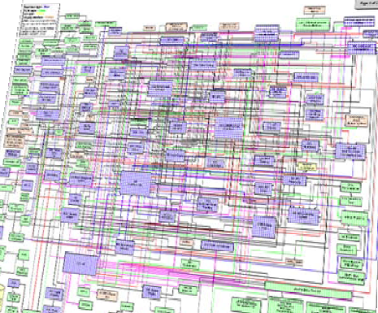
Data Sources and Heterogeneity
Course Motivation and Goals
Terminology
  Integration (Latin integer = whole): consolidation of data objects / sources
  Homogeneity (Greek homo/homoios = same): similarity
  Heterogeneity: dissimilarity, different representation / meaning
Heterogeneous IT Infrastructure
  Common enterprise IT infrastructure contains >100s of
  heterogeneous and distributed systems and applications
  E.g., health care data management: 20 - 120 systems
Multi-Modal Data (example health care)
  Structured patient data, patient records incl. prescribed drugs
  Knowledge base drug APIs (active pharmaceutical ingredients) + interactions
  Doctor notes (text), diagnostic codes, outcomes
  Radiology images (e.g., MRI scans), patient videos
  Time series (e.g., EEG, ECoG, heart rate, blood pressure)

Slide 11
The Data Science Lifecycle
Data Science Lifecycle
Classic KDD Process (Knowledge Discovery in Databases)
  Descriptive (association rules, clustering) and predictive
  1990-2010
Evaluate
Mining
Transform
Preprocess
Select
[Usama M. Fayyad, Gregory Piatetsky-Shapiro, Padhraic Smyth: From Data Mining to Knowledge Discovery in Databases. AI Magazine 17(3) (1996)]

Slide 12
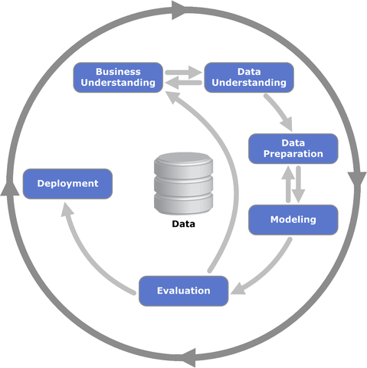
The Data Science Lifecycle, cont.
Data Science Lifecycle
CRISP-DM
  CRoss-Industry
  Standard Process for
  Data Mining
  Additional focus on
  business understanding
  and deployment
[https://statistik-dresden.de/archives/1128]

Slide 13




The Data Science Lifecycle, cont.
Data Science Lifecycle
Data-centric View:
Application perspective
Workload perspective
System perspective
Data extraction, schema alignment, entity resolution, data validation, data cleaning, outlier detection, missing value imputation, semantic type detection, data augmentation, feature selection, feature engineering, feature transformations
Data Scientist
Data Integration
Data Cleaning
Data Preparation
Model Selection
Training
Hyper-parameters
Validate & Debug
Deployment
Scoring & Feedback
Data Integration
Data Cleaning
Data Preparation
Exploratory Process
(experimentation, refinements, ML pipelines)
Data/SW Engineer
DevOps Engineer
Key observation: SotA
data integration/cleaning based on ML

Slide 14
The 80% Argument
Data Science Lifecycle
Data Sourcing Effort
  Data scientists spend 80-90% time on
  finding, integrating, cleaning datasets
Technical Debts in ML Systems
  Glue code, pipeline jungles, dead code paths
  Plain-old-data types (arrays), multiple languages, prototypes
  Abstraction and configuration debts
  Data testing, reproducibility, process management, and cultural debts
[Michael Stonebraker, Ihab F. Ilyas: Data Integration: The Current Status and the Way Forward.
IEEE Data Eng. Bull. 41(2) (2018)]
ML
[D. Sculley et al.: Hidden Technical Debt in Machine Learning Systems. NIPS 2015]

Slide 15

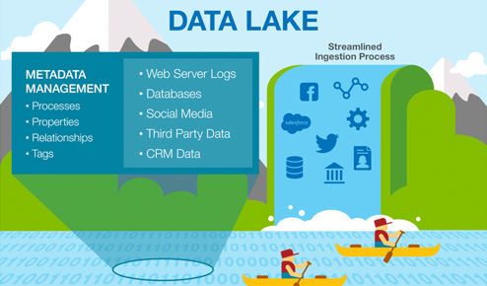



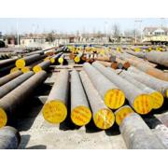


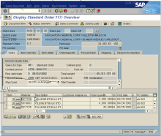
Complementary
Architectures
Course Motivation and Goals
Distributed Computation
Frameworks
#1 Information System Pyramid
#2 Data
Lake
Audio, Image, Video, Text, Streams, Logs
Operational Systems
Strategic
Systems
Analytical Systems
DSS
Vertical Integration
(e.g., ETL)
Catalogs
Distributed Data Stores
DWH
Material
ERP
CRM
SCM
eCommerce
Horizontal Integration (e.g., EAI)
Notes:
Integration Architecture

Slide 16
Course Goals
Course Motivation and Goals
#1 Major data integration architectures
#2 Key techniques for data integration and cleaning
#3 Methods for large-scale data storage and analysis

Slide 17
Course Outline and Projects

Slide 18
Part A: Data Integration and Preparation
Course Outline and Projects
Data Integration Architectures
01 Introduction and Overview [Oct 06]
02 Data Warehousing, ETL, and SQL/OLAP [Oct 13]
03 Message-oriented Middleware, EAI, and Replication [Oct 20]
Key Integration Techniques
04 Schema Matching and Mapping [Oct 27]
05 Entity Linking and Deduplication [Nov 03]
06 Data Cleaning and Data Fusion [Nov 10]

Slide 19
Part B: Large-Scale Data Management & Analysis
Course Outline and Projects
Cloud Computing
07 Cloud Computing Foundations [Nov 17]
08 Cloud Resource Management and Scheduling [Nov 24 ]
09 Distributed Data Storage [Dec 01]
Large-Scale Data Analysis
10 Distributed, Data-Parallel Computation [Dec 15]
11 Distributed Stream Processing [Jan 12]
12 Distributed Machine Learning Systems [Jan 19]

Slide 20
Overview Projects or Exercises
Course Outline and Projects
Team
  1-3 person teams (w/ clearly separated responsibilities)
Objectives
  Non-trivial programming project in DIA context (2 ECTS → 50 hours)
  Exercise: Data engineering and ML pipeline
    Data cleaning and integration of multi-modal data sources
    ML model training and evaluation
  Optional: Open source contribution to Apache SystemDS
  https://github.com/apache/systemds (from HW to high-level scripting)
Timeline
  Oct 20: Exercise description
  Jan 12: Final project/exercise deadline

Slide 21
Summary and Q&A
Course Goals
  #1 Major data integration architectures
  #2 Key techniques for data integration and cleaning
  #3 Methods for large-scale data storage and analysis
Next Lectures
  02 Data Warehousing, ETL, and SQL/OLAP [Oct 13]
  03 Message-oriented Middleware, EAI, and Replication [Oct 20]

